Slide 1



Predicting Rain Patterns in Australia
Justin Grisanti

Slide 2
Objectives – 5 Step Model
Obtain a Business Understanding
Understand the Data
Prepare Data for Modeling
Create Models
Generate Results

Slide 3
Business Understanding
Stakeholders:
Australian Bureau of Meteorology
Citizens of Australia
Business Problem
Bureau of Meteorology historically underpredicts rainy days each year
Goals/Value-add
Help the Bureau better inform the citizens of Australia of whether it will rain tomorrow
Provide a model to the Bureau of Meteorology that can be used in conjunction with their own findings to reduce the amount of underpredictions

Slide 4

Data Understanding
Various Weather Data
Dates from 2008 - 2017
Location
Wind Patterns
Sunshine Data
Cloud Data
Humidity
Temperature
Rainfall

Slide 5
Data Preparation
Use data cleaning techniques to prepare data
Outliers
Nulls
Errors
Better data equals a better model

Slide 6
Modeling
Redefine the Problem
Bureau of Meteorology historically underpredicts rainy days each year
Modeling Solution
Our model should minimize false negatives (Type II error)
False Negatives: Days predicted that it won’t rain, and it actually ends up raining
Using Recall to minimize Type II error
Logistic Regression, k-Nearest Neighbors & Decision Trees

Slide 7
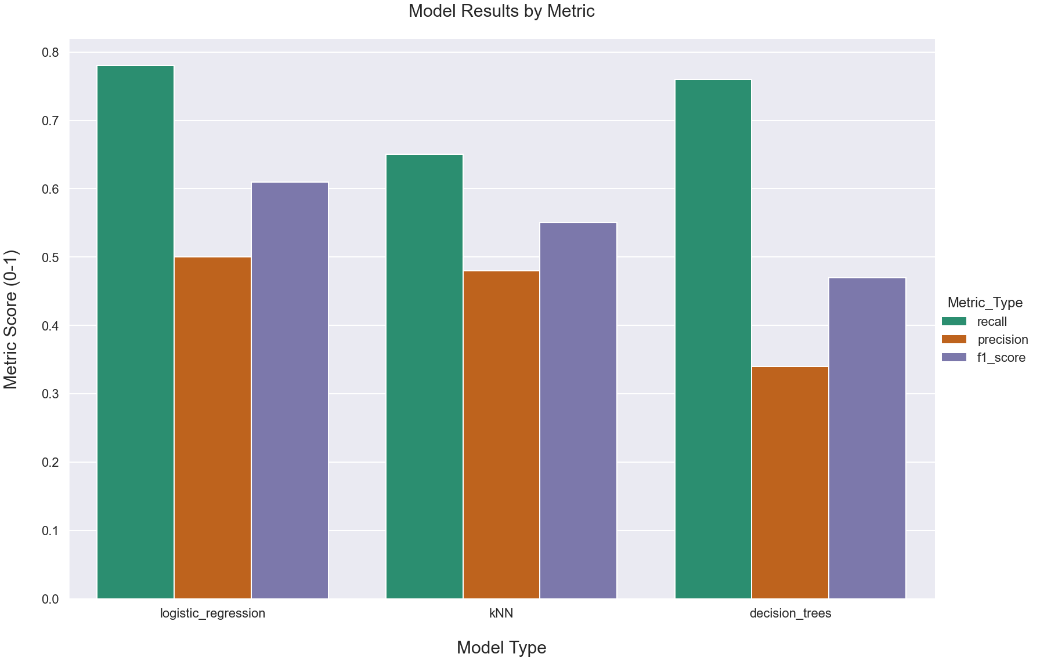
Model Performance
Notes:
Input features, will predict if it will rain the next day.

Slide 8
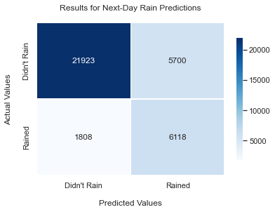
Best Model Results
Best Model: Logistic Regression with a weighted-average 79% recall score
Actually Rained Next Day:
Correctly classified that it would rain 77% of the time
Actually Did Not Rain The Next Day:
Correctly classified that it would not rain 79% of the time.
Value: Model prevents False Negatives 80% of the time
Notes:
Input features, will predict if it will rain the next day.

Slide 9
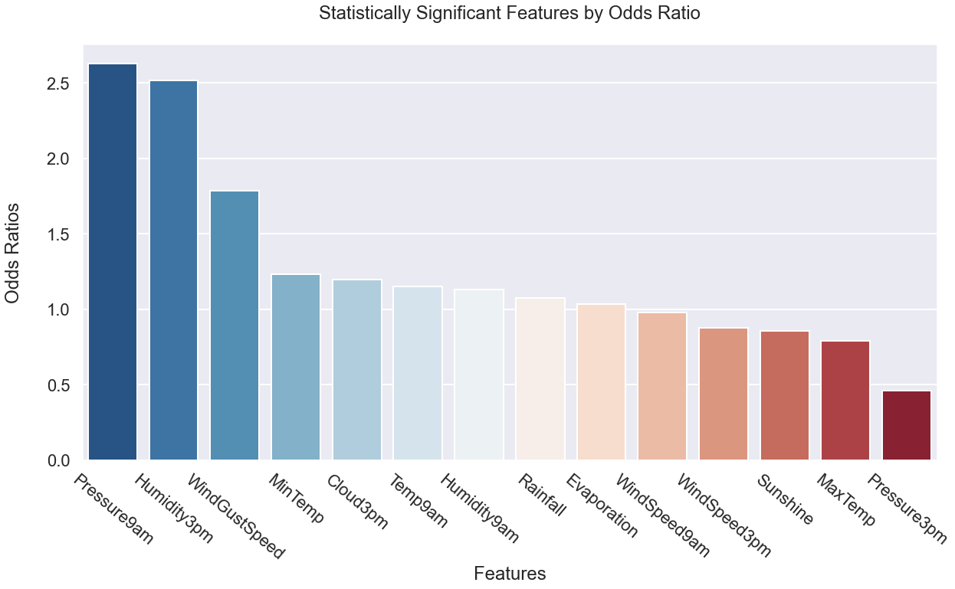
Best features
Notes:
As we can see above, Pressure at 9am and Humidity are the most important positive features according to our models, at an odds ratio of 2.63 and 2.52, respectively. Next best is wind gust speed at an odds ratio of roughly 1.78. This means that:
An increase of 1 hectopascal of pressure at 9am is associated with a 163% increase in the odds that it will rain the next day.
An increase of 1 percentage point in humidity at 3pm is associated with a 152% increase in the odds that it will rain the next day.
An increase of 1 kilometer per hour for the day's strongest wind speed is associated with a 78% increase in the odds that it will rain the next day.
After these three variables, our remaining variables that were statistically significant vary from odds ratios from 1.2 down to .5.
Note that the most important negative features are Sunshine, Max Temp, and Pressure 3pm at odds ratios, of .86, .79, and .46, respectively, meaning:
An increase of 1 hectopascal of pressure at 3pm is associated with a 54% decrease in the odds that it will rain the next day.
An increase of 1 degree (C) of the max temperature during a day is associated with a 21% decrease in the odds that it will rain the next day.
An increase of 1 hour of sunshine during a day is associated with a 14% decrease in the odds that it will rain the next day.

Slide 10
Next Steps:
Find more data with different features (i.e. fog, high/low temperature, more cloud data)
Try different model techniques
Find a way to strengthen our Precision metric (reduce Type I error)

Slide 11
Thank You For Your Time!

